Slide 1
ALGORITHMS Introduction
Asma Fariha
Lecturer, Department of Computer Science
American International University-Bangladesh (AIUB)
asma.fariha@aiub.edu

Slide 2
What will we learn
in this course?

Slide 3
Course Objectives
The objective of this course is
How we can compare algorithms
Complexity analysis of algorithms
How effective data structures could be used to solve different problems
And implementation of different algorithms with the practical examples
Exercise your creativity in designing algorithms.

Slide 4
The Goals of this Course
To think algorithmically
To understand and learn the idea behind algorithm design techniques
To get to know a toolbox of classical algorithms.
To reason (in a precise and formal way) about the efficiency and the correctness of algorithms.

Slide 5
Course Prerequisites
Programming
Data types, operations
Conditional statements
Loops
Procedures and functions
C/ C++/ Java
Discrete Mathematics (proof theorems)
Data Structures (array, structure, pointer, linked list, file, etc...)

Slide 6
Course Contents
Introduction to Algorithms
Analysis of Algorithms
RAM model, Basic notation
Recurrences & Master Method
Dynamic Programming
Greedy strategy
Graphs Algorithms
Greedy Graph Algorithm
Shortest Path Algorithms
Basic idea of NP – Completeness
Basic idea of Elementary Geometric Methods & Review

Slide 7
Resources & References
Introduction to Algorithms, Third Edition, Thomas H. Cormen, Charle E. Leiserson, Ronald L. Rivest, Clifford Stein (CLRS).
Fundamental of Computer Algorithms, Ellis Horowitz, Sartaj Sahni, Sanguthevar Rajasekaran (HSR)
Helpful link for Problem Solving : http://acm.uva.es/problemset/
Lectures and Laboratory works will be provided online at the course website weekly.

Slide 8
What is an Algorithm?
A set of steps to accomplish a task

Slide 9
Informally
takes some value or set of values as input
produces some value or set of values, as output
Algorithm: any well-defined computational procedure
An algorithm is thus a sequence of computational steps that transform the input into the output.
Solving a given problem:
Data structure: Organization of data to solve the problem at hand.
Algorithm: Outline, the essence of a computational procedure, step-by-step instructions.
Program: Implementation of an algorithm in some programming language.

Slide 10
Kinds of Problem to be solved
Sorting and Searching are the basic and most common computational problem.
Clever algorithms are employed for the Internet
To manage large volume of data transfer
Finding good routes on which the data will travel
Search engine to quickly find requested pages
Etc…
Numerical algorithms and number theory are employed in electronic commerce to keep and secure information such as credit card numbers, passwords, and bank statements.

Slide 11
Kinds of Problem to be solved
Allocating scarce resources in the most beneficial way
An oil company may wish to know where to place its wells in order to maximize its expected profit.
A candidate may want to determine where to spend money buying campaign advertising in order to maximize the chances of winning at election.
An airline may wish to assign crews to flight in the least expensive way possible, making sure that each flight is covered and that government policy regarding crew policies are met.
Etc…

Slide 12
Algorithmic problem
Specification of output as a function of input
Specification of input
Algorithm
Finite number of input instances satisfying the specification.
For example:
A sorted, non-decreasing sequence of natural numbers. The sequence is of non-zero, finite length:
1, 20, 908, 909, 100000, 1000000000.
3.

Slide 13
Algorithmic Solution
Input instance, adhering to the specification
Output related to the input as required
Algorithm
Algorithm describes actions on the input instance.
There may be many correct algorithms for the same algorithmic problem.

Slide 14
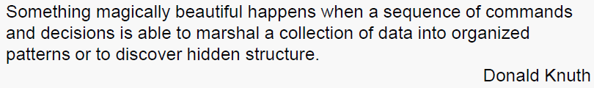
Definition of an Algorithm
An algorithm is a sequence of unambiguous instructions for solving a problem, i.e., for obtaining a required output for any legitimate input in a finite amount of time.

Slide 15
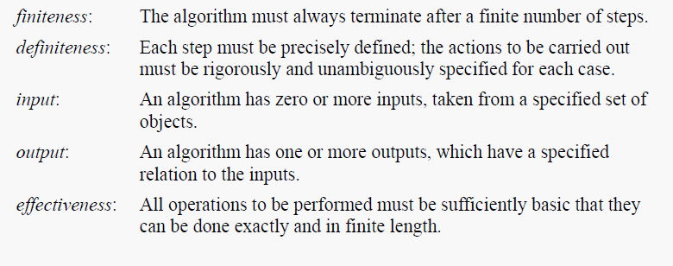
Properties of Algorithms

Slide 16
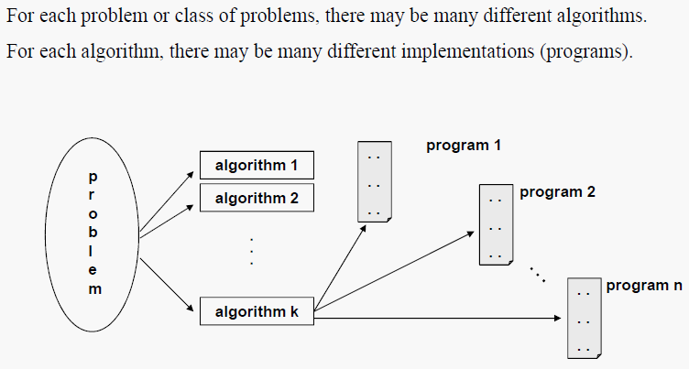
Problems vs Algorithms vs Programs

Slide 17
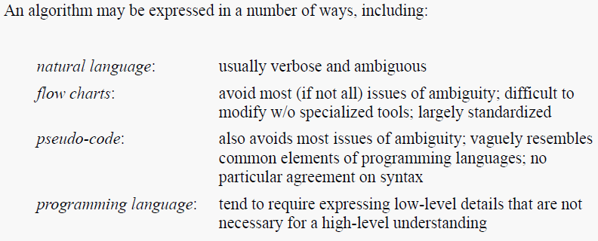
Expressing Algorithms

Slide 18
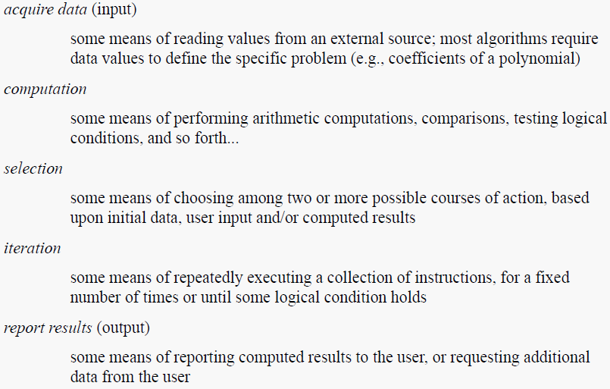
Common Elements of Algorithms

Slide 19
Starting with Sorting Algorithm - Example

Slide 20
Sorting
Arrangement of data in certain order
Key
The basis of sorting data/record
Part of data used for sorting
Numerical or lexicographical order
Ascending or Descending
Optimize other algorithm
Such as searching technique
Which requires sorted input list

Slide 21
Classification
Comparison and non-comparison Sorting
Comparison : Compare elements based on key. Ex: Insertion Sort
Non-Comparison : use distribution and frequency etc parameter. Ex: Counting Sort
In-place Sorting and Not-in-place Sorting
In-Place: No extra space required. Ex: Insertion sort
Not-In-Place: Extra space more than input record required. Ex: Merge Sort

Slide 22
Classification (Cont.)
Stable and Not Stable Sorting
Stable: sequence of similar content maintained
Unstable: original sequence is not maintain in sorted output
Adaptive and Non-Adaptive Sorting
Adaptive: takes advantage of already 'sorted' elements
Non-Adaptive: try to force every single element to be re-ordered

Slide 23
Bubble Sort
The algorithm, which is a comparison sort, is named for the way smaller or larger elements "bubble" to the top of the list.
The bubble sort makes multiple passes through a list. It compares adjacent items and exchanges those that are out of order. Each pass through the list places the next largest value in its proper place. In essence, each item “bubbles” up to the location where it belongs.

Slide 24
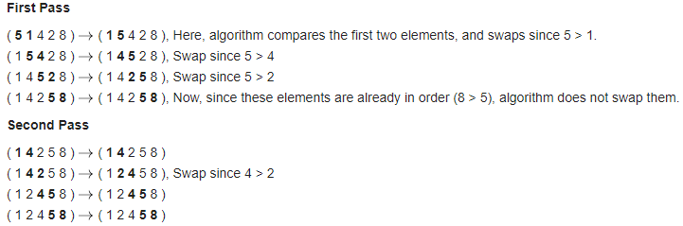
Bubble Sort-Algorithm
for ( i=1 to n-1 ) for ( j=1 to n-1 ) if ( A[j] >A[j+1] ) temp = A[j] A[j] = A[j+1] A[j+1] = temp end-if end-for end-for

Slide 25
Selection Sort
We find the smallest number in the array and bring it to the position 1. We do the same process with the remaining part of the array and bring the smallest number among the remaining array to the next position. This process continues till the time all the positions of the array are filled with the elements. Thus the main idea of selection sort is that
find the smallest element
put it in the first position
find the next smallest element in the remaining elements
put it in the second position
And so on, until we get to the end of the array

Slide 26
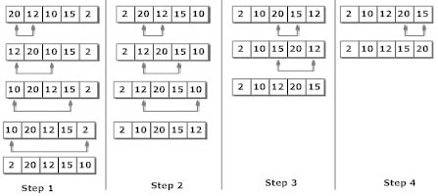
Selection Sort-Algorithm
for ( i=0 to n-1) smallSub = I for ( j=i+1 to n-1 ) if ( A[j] < A[smallSub]) smallSub = j end-if end-for temp = A[i] A[i] = A[smallSub] A[smallSub] = temp end-for

Slide 27
Insertion Sort
Simple Implementation
Efficient for small data set
Comparison Sort: Compare adjacent elements
Swap them if out of order
Adaptive sort: For Pre-sorted List
Only one comparison per element required
Stable Sort: as doesn’t change ordering of elements with equal keys
In-Place Sort: Only constant O(1) additional memory

Slide 28
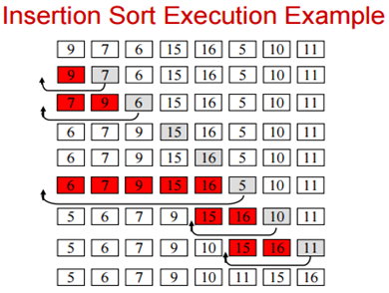
Insertion Sort-Algorithm
for (j=2 to A.length) key = A[j] i = j-1 while i > 0 and A[i] > key A[i+1] = A[i] i = i-1 end-while A[i+1] = key End-for

Slide 29
Insertion Sort-Complexity
Time Complexity: O(n*n)
Auxiliary Space: O(1)
Boundary Cases:
maximum time to sort if elements are sorted in reverse order
minimum time (Order of n) when elements are already sorted

Slide 30
At a Glance
Bubble Sort | Selection Sort | Insertion Sort
for ( i=1 to n-1 ) for ( j=1 to n-1 ) if ( A[j] >A[j+1] ) temp = A[j] A[j] = A[j+1] A[j+1] = temp end-if end-for end-for | for ( i=1 to n-1) smallSub = I for ( j=i+1 to n-1 ) if ( A[j] < A[smallSub]) smallSub = j end-if end-for temp = A[i] A[i] = A[smallSub] A[smallSub] = temp end-for | for (j=2 to A.length) key = A[j] i = j-1 while i > 0 and A[i] > key A[i+1] = A[i] i = i-1 end-while A[i+1] = key End-for

